Slide 1
School of Computer Science and Engineering B.Tech (CSE) 2nd Semester
Course Name : OOPs with C++
Course Code: Topic: Beginning with C++ (Unit-2)
Dr. Sahil Kansal

Slide 2
Input / Output Stream
In C++ input and output is performed in the form of sequence of bytes or more commonly known as streams
Input Stream: If the direction of flow of bytes is from device(for example Keyboard) to the main memory then this process is called input.
Output Stream: If the direction of flow of bytes is opposite, i.e. from main memory to device( display screen ) then this process is called output.
iostream: It stands for standard input output stream. This header file contains definitions to objects like cin, cout etc.

Slide 3
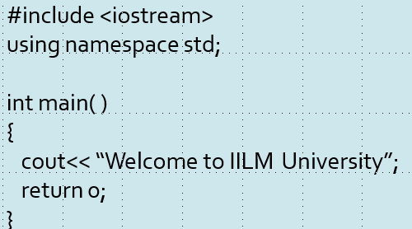
Standard Output stream (cout)
The data needed to be displayed on the screen is inserted in the standard output stream (cout) using the insertion operator (<<).
For Example:

Slide 4
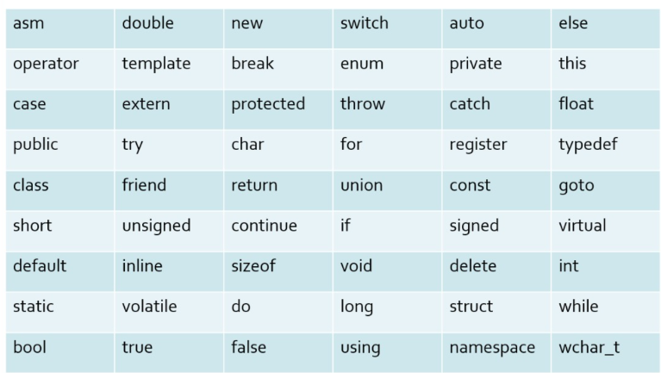
Keyword

Slide 5
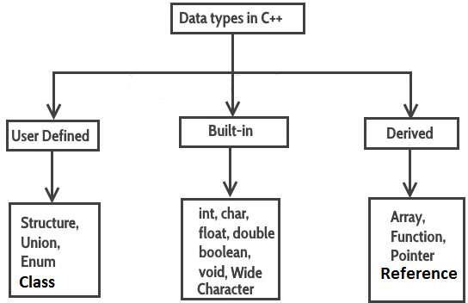
Data Types

Slide 6
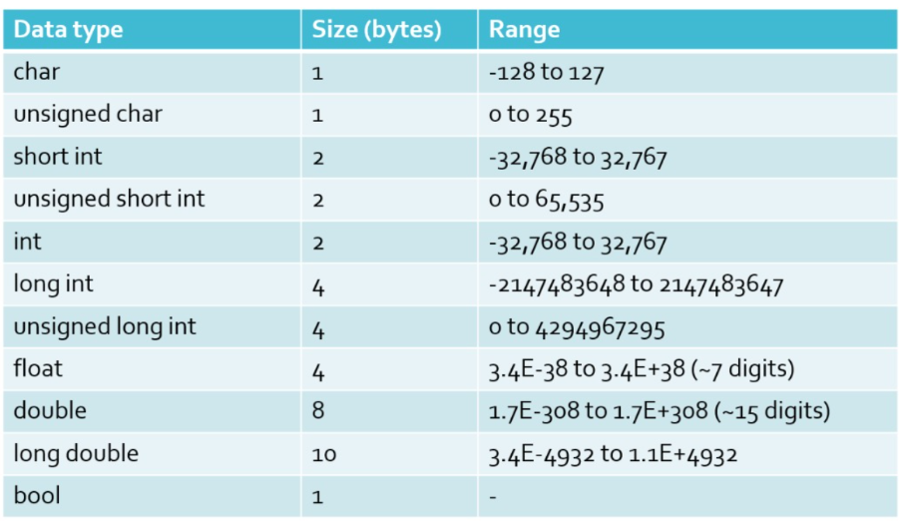
Size and Range of data types

Slide 7
Boolean Data type
Syntax
bool variable_name;
Example:
bool b;
In C++, the data type bool has been introduced to hold a Boolean
value, true or false.
The default numeric value of true is 1 and false is 0

Slide 8
Reference Variables
When a variable is declared as reference, it becomes an alternative
name for an existing variable.
A variable can be declared as reference by putting ‘&’ in the
declaration.
Syntax:
Datatype &reference_name = variable_name
For example:
float total = 100; float &sum = total;

Slide 9
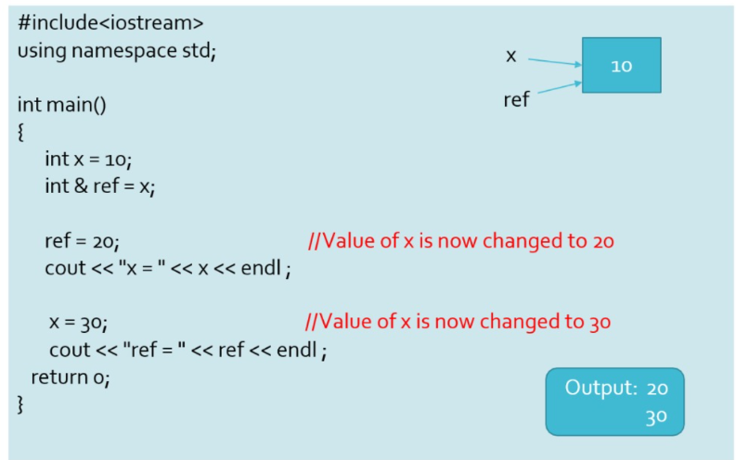
Example

Slide 10
Enum
To create user defined type names the keyword enum is used.
An enumeration is set of named integer constants.
An enumerated data type provides a way to attach name to the numbers. The keyword enum automatically enumerates the list of words by assigning 0,1,2… and so on.
Syntax: enum name {List of names} variables;
Example:-
enum color { red , green, blue};
color background; // background is type of color
background = blue; // allowed background = 7; // Warning in C++ background = (color) 7; // OK

Slide 11
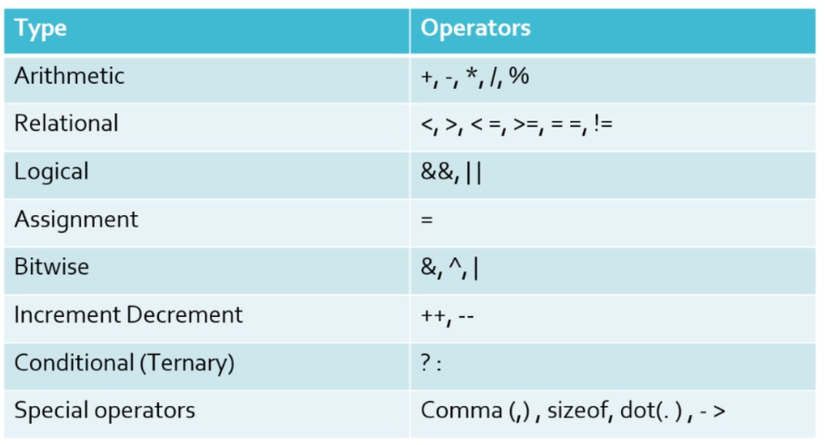
Operators

Slide 12
Scope Resolution Operator
Use1: To access global version of data
Like C, C++ is also a block-structured language. Blocks and scopes
can be used in constructing programs.
Same variable name can be used to have different meanings in different blocks.
The scope of the variable extends from the point of its declaration till the end of the block containing the declaration.
Scope resolution operator allows access to the global version of a variable.
This can be used to uncover a hidden variable.
Syntax:
:: variable-name

Slide 13
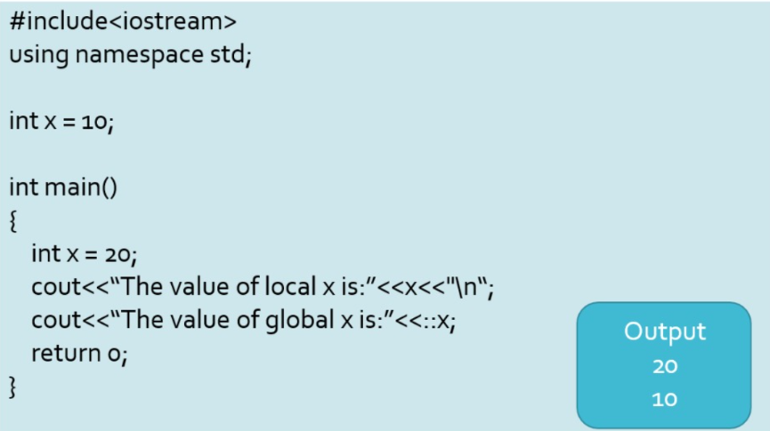
Scope Resolution Operator

Slide 14
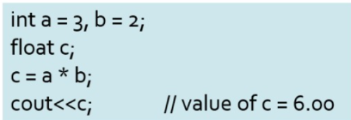
Type Conversion
Type conversion occurs when the expression has data of mixed data types. Example of such expression include converting an integer value into a float value.
In type conversion, the data type is promoted from lower to higher because converting higher to lower involves loss of precision and value.
double>float>long>int>short>char
Ex:

Slide 15
Type conversion
Type conversion in C++ is the process of converting a value from one data type to another. It is mainly classified into:
Implicit Type Conversion (Automatic): The compiler automatically converts one data type into another without programmer intervention.
Eg:
int a = 10;
float b = a;
Explicit Type Conversion (Type Casting): The programmer explicitly forces conversion of one data type to another.
Eg:
int x = 10, y = 3;
float result = (float)x / y;

Slide 16
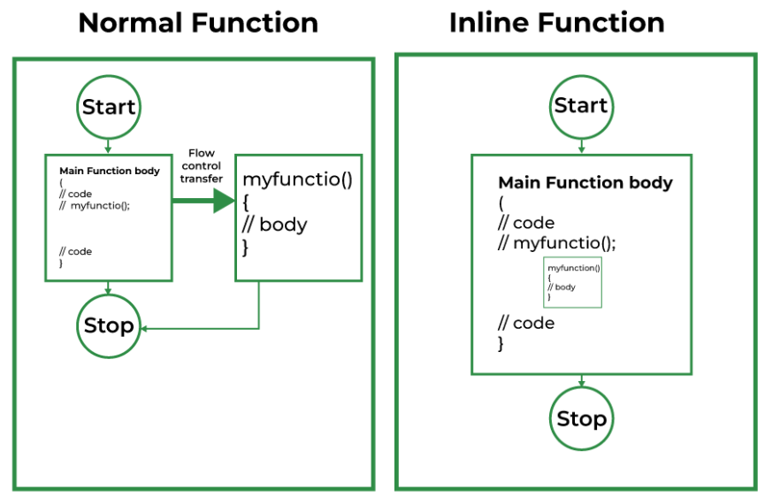
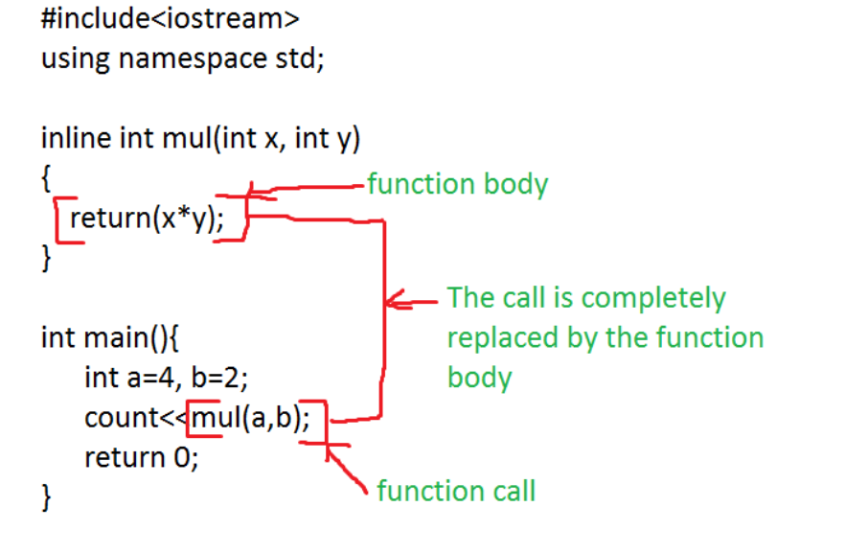
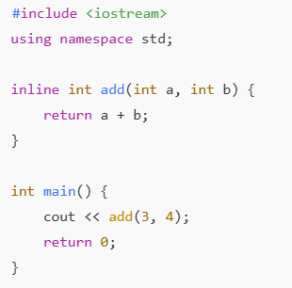
Inline Functions
Definition
An inline function is a function for which the compiler replaces the function call with the actual function code at the time of compilation.

Slide 17
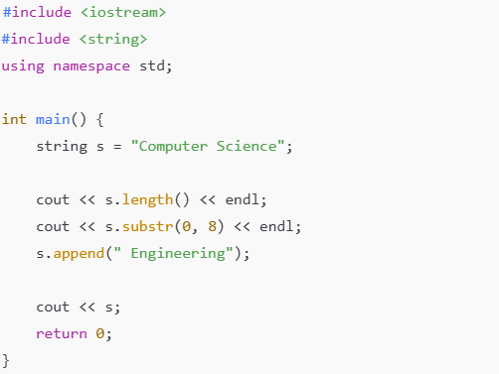
String class
The string class is a built-in C++ class (part of the Standard Library) used to store and manipulate text (strings) easily and safely. It overcomes the limitations of C-style strings (char[]).
Function | Description
length() / size() | Returns length of string
empty() | Checks if string is empty
append() | Adds string at end
clear() | Clears string
compare() | Compares two strings
substr() | Extracts substring
find() | Finds position of substring
erase() | Removes characters
replace() | Replaces part of string

Slide 18
String Class
String Class Operator | Use
+ | Concatenation
= | Assignment
==, != | Comparison
<, > | Lexicographical comparison
[] | Access character
Why Use string Class?
C-style strings have problems like:
Fixed size
Buffer overflow risk
Manual memory management
Limited built-in operations
The string class provides:
Dynamic memory allocation
Automatic memory management
Rich set of member functions
Safe and efficient string handling

Slide 19
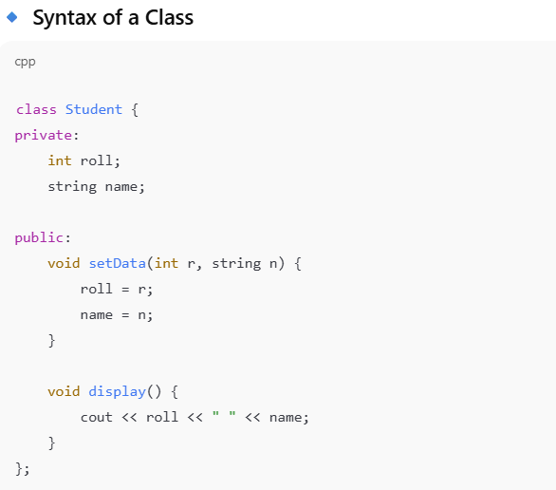
Specifying Classes and Objects.
A class in C++ is a user-defined data type that acts as a blueprint for creating objects. It defines:
Data members (variables)
Member functions (functions)
Specifying / Defining Objects
An object is an instance of a class. Objects are specified (created) using the class name.

Slide 20
Thanks

